Slide 1
ICCAD-2017 CAD Contest in Net Open Location Finder with Obstacles
Problem Description, Benchmarks, and Results
Kai-Shun Hu, Ming-Jen Yang, Yu-Hui Huang, Bing-Yi Wong, and Cindy Shen
Nov 13th, 2017

Slide 2
Outline
Problem Description
Evaluation Methodology
Benchmarks
Results

Slide 3
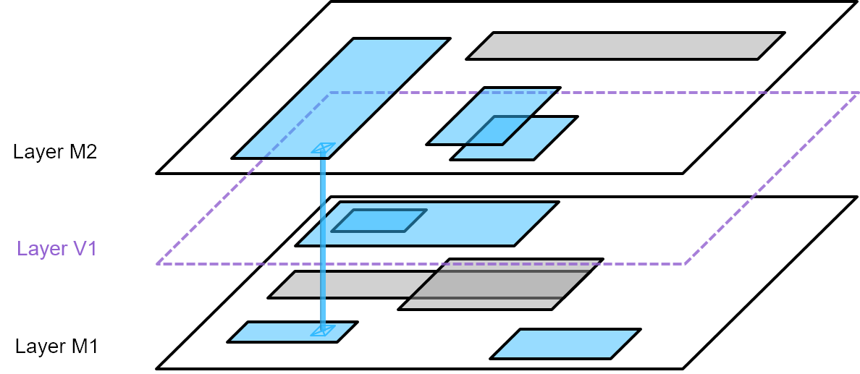
Problem Description
Develop a tool
  Detect if a net is open after placement & routing (P&R) stage
  Indicate the (shortest) paths to reconnect existing net shapes to resolve open
  Obstacle awareness
Given
  a set of routed net shapes R = {R₁, R₂, …, R_{j}}
  a set of routed net vias V = {v₁, v₂, …, v_{k}}
  a set of obstacles O = {O₁, O₂, …, O_{m}}
  routing layers L = {M1, V1, M2, V2, …, Vn-1, Mn}
  design boundary B
  minimum spacing S
  via cost C_{v}

Slide 4
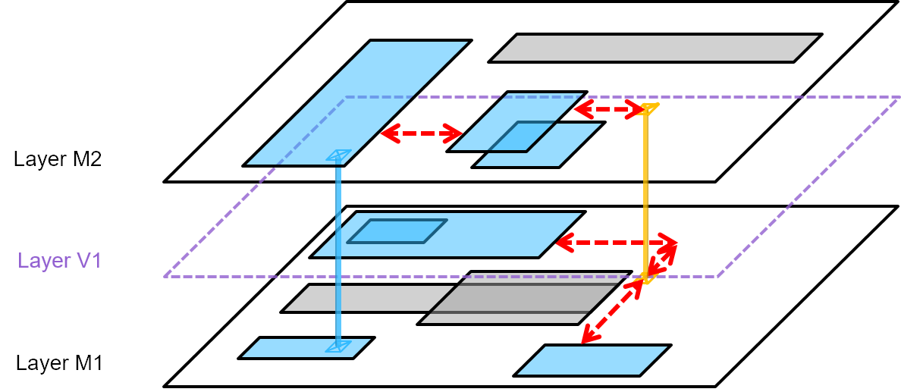
Problem Description
Output
  a set of paths p = {p₁, p₂, …, p_{l}} to connect all R and V together
    each path p_{i} can be a H-line, a V-line, or a via
Challenges
  Large amount of existing routing shapes
  Geometries not Points
  Multi-layer
  Runtime
    Seek for fast solution to solve a large net open problem
    Multi-threading is encouraged
    4-core machine provided

Slide 5
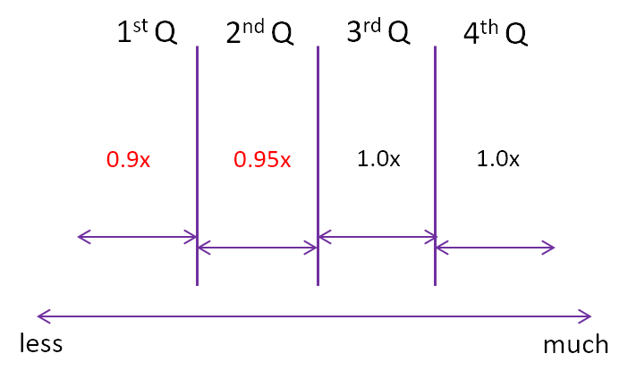
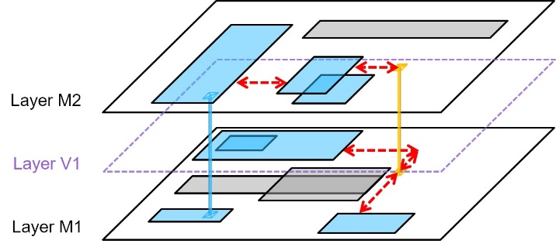
Evaluation Methodology
Overall cost
Runtime bonus
runtime

Slide 6
Benchmarks
Public cases
Hidden cases
Name | #Layers | #RoutedShapes | #Obstacles | #Components
case1 | 3 | 1503 | 414 | 113
case2 | 5 | 4518 | 4773 | 1602
case3 | 8 | 97146 | 79012 | 18438
caseA | 8 | 104492 | 69491 | 21137
Name | #Layers | #RoutedShapes | #Obstacles | #Components
case4 | 3 | 1941 | 421 | 216
case5 | 5 | 4450 | 4762 | 1663
case6 | 8 | 94100 | 77969 | 31163
caseB | 8 | 97019 | 81852 | 32045

Slide 7
Results
Alpha
Beta
 | case1 | case2 | case3 | caseA | case4 | case5 | case6 | caseB
Team | Cost with runtime bonus | Cost with runtime bonus | Cost with runtime bonus | Cost with runtime bonus | Cost with runtime bonus | Cost with runtime bonus | Cost with runtime bonus | Cost with runtime bonus | sum of Cost
Top1 | 5615.5 | 112608.0 | 1757681.0 | - | 11179.6 | 69936.2 | 3272724.0 | - | -
Top2 | 10354.0 | 283169.7 | 8603366.4 | - | 16574.4 | 405935.1 | 11516518.8 | - | -
Top3 | 5852.0 | 91617.1 | 1682141.4 | - | 1418378.0 | 39835263.2 | 3644879.4 | - | -
Top4 | 222898.5 | 13639418.1 | 2771104479.8 | - | 307918.8 | 15119409.6 | 3504707256.4 | - | -
Top5 | 1263615.0 | 80939003.0 | 6513229278.1 | - | 2462976.0 | 79419405.0 | 14062146000.6 | - | -
Top6 | 5346.0 | 79032.6 | 21578259186.0 | - | 10374.0 | 53983.8 | 28059542442.0 | - | -
 | case1 | case2 | case3 | caseA | case4 | case5 | case6 | caseB
Team | Cost with runtime bonus | Cost with runtime bonus | Cost with runtime bonus | Cost with runtime bonus | Cost with runtime bonus | Cost with runtime bonus | Cost with runtime bonus | Cost with runtime bonus | sum of Cost
Top1 | 3373.5 | 65532.0 | 774949.2 | 1243805.6 | 8730.9 | 23102.0 | 1451527.2 | 4800562.2 | 8371582.5
Top2 | 3501.9 | 62834.4 | 793566.9 | 1221963.3 | 9336.6 | 26946.0 | 1589137.2 | 4920687.0 | 8627973.3
Top3 | 3589.0 | 67766.0 | 743067.2 | 1231049.0 | 9831.0 | 22772.0 | 1529955.1 | 5137222.9 | 8745252.1
Top4 | 3945.4 | 71829.5 | 883606.0 | 1358057.0 | 10544.0 | 29694.2 | 1746400.0 | 5485610.0 | 9589686.0
Top5 | 5346.0 | 79032.6 | 1308958.2 | 1588569.3 | 9828.0 | 53983.8 | 2529135.0 | 5509345.5 | 11084198.4
Top6 | 4803.2 | 83946.8 | 1120525.0 | 1679905.0 | 11668.9 | 42489.7 | 2394072.2 | 6340824.4 | 11678235.1

Slide 8
Results
Beta
Final
 | case1 | case2 | case3 | caseA | case4 | case5 | case6 | caseB
Team | Cost with runtime bonus | Cost with runtime bonus | Cost with runtime bonus | Cost with runtime bonus | Cost with runtime bonus | Cost with runtime bonus | Cost with runtime bonus | Cost with runtime bonus | sum of Cost
Top1 | 3373.5 | 65532.0 | 774949.2 | 1243805.6 | 8730.9 | 23102.0 | 1451527.2 | 4800562.2 | 8371582.5
Top2 | 3501.9 | 62834.4 | 793566.9 | 1221963.3 | 9336.6 | 26946.0 | 1589137.2 | 4920687.0 | 8627973.3
Top3 | 3589.0 | 67766.0 | 743067.2 | 1231049.0 | 9831.0 | 22772.0 | 1529955.1 | 5137222.9 | 8745252.1
Top4 | 3945.4 | 71829.5 | 883606.0 | 1358057.0 | 10544.0 | 29694.2 | 1746400.0 | 5485610.0 | 9589686.0
Top5 | 5346.0 | 79032.6 | 1308958.2 | 1588569.3 | 9828.0 | 53983.8 | 2529135.0 | 5509345.5 | 11084198.4
Top6 | 4803.2 | 83946.8 | 1120525.0 | 1679905.0 | 11668.9 | 42489.7 | 2394072.2 | 6340824.4 | 11678235.1
 | case1 | case2 | case3 | caseA | case4 | case5 | case6 | caseB
Team | Cost with runtime bonus | Cost with runtime bonus | Cost with runtime bonus | Cost with runtime bonus | Cost with runtime bonus | Cost with runtime bonus | Cost with runtime bonus | Cost with runtime bonus | Sum of Cost
Top1 | 3264.3 | 58868.1 | 664135.2 | 1136219.4 | 8998.2 | 19053.9 | 1465547.0 | 4794177.6 | 8150263.7
Top2 | 3238.2 | 59565.6 | 692782.2 | 1153764.9 | 8756.1 | 19727.1 | 1424065.5 | 4801906.8 | 8163806.4
Top3 | 3238.2 | 64725.0 | 696948.5 | 1198014.6 | 9380.7 | 19719.2 | 1387701.9 | 4792124.7 | 8171852.8
Top4 | 3397.2 | 62118.6 | 663411.6 | 1140454.8 | 9738.0 | 19771.4 | 1391601.6 | 5175015.8 | 8465509.0
Top5 | 3424.8 | 62781.7 | 691474.5 | 1217632.1 | 9305.3 | 21023.5 | 1497013.8 | 5068548.3 | 8571203.9
Top6 | 3548.0 | 65647.0 | 715172.4 | 1210209.8 | 9266.3 | 21451.0 | 1485483.7 | 5065288.9 | 8576066.9

Slide 9
Results
case3
case3 overall cost
w/o runtime bonus
More vias used

Slide 10
Results
case3
Vias & stacked via

Slide 11
Results
case3
Runtime (Elapsed real time)
CPU time / Elapsed real time
 | top1- case3 | top2- case3 | top3- case3 | top4- case3
Alpha | 1.00 | 1.00 | 1.00 | 0.97
Beta | 0.97 | 2.56 | 0.94 | 1.00
Final | 3.01 | 1.00 | 0.88 | 1.65

Slide 12
Award Announcement

Slide 13
Third Place
Team cada009 : SYFisGod
National Taiwan University of Science and Technology
Taiwan
Guan-Qi Fang
Yong Zhong
Yi-Hao Cheng
Prof. Shao-Yun Fang

Slide 14
Second Place
Team cada065 : DoublePai
National Taiwan University
Taiwan
Chia-Cheng Pai
Yu-Cheng Pai
Jing-Syuan Huang
Prof. Yao-Wen Chang, Prof. Chien-Mo James Li
Prof. Jie-Hong Roland Jiang, Prof. Chung-Ping Charlie Chen

Slide 15
First Place
Team cada066 : CCU EDA Route
National Chung Cheng University
Taiwan
Shuo-Hui Wang
Yan-Yu Su
Wei-Liang Wu
Guan-Hong Liou
Prof. Mark Po-Hung Lin

Slide 17
Top3 Result
 | case1 |  |  |  | case2 |  |  |  | case3 |  |  |  | caseA
Team | Overall Cost | Runtime (Elapsed real time) | Runtime bonus factor | Cost with runtime bonus | Overall Cost | Runtime (Elapsed real time) | Runtime bonus factor | Cost with runtime bonus | Overall Cost | Runtime (Elapsed real time) | Runtime bonus factor | Cost with runtime bonus | Overall Cost | Runtime (Elapsed real time) | Runtime bonus factor | Cost with runtime bonus
Top1-cada066 | 3627 | 0m0.037s | 0.9 | 3264.3 | 65409 | 0m0.597s | 0.9 | 58868.1 | 737928 | 0m33.464s | 0.9 | 664135.2 | 1262466 | 0m38.305s | 0.9 | 1136219.4
Top2-cada065 | 3598 | 0m0.051s | 0.9 | 3238.2 | 66184 | 0m0.924s | 0.9 | 59565.6 | 769758 | 0m25.407s | 0.9 | 692782.2 | 1281961 | 0m23.788s | 0.9 | 1153764.9
Top3-cada009 | 3598 | 0m0.075s | 0.9 | 3238.2 | 64725 | 0m2.544s | 1 | 64725.0 | 733630 | 1m54.595s | 0.95 | 696948.5 | 1261068 | 0m51.271s | 0.95 | 1198014.6
 | case4 |  |  |  | case5 |  |  |  | case6 |  |  |  | caseB
Team | Overall Cost | Runtime (Elapsed real time) | Runtime bonus factor | Cost with runtime bonus | Overall Cost | Runtime (Elapsed real time) | Runtime bonus factor | Cost with runtime bonus | Overall Cost | Runtime (Elapsed real time) | Runtime bonus factor | Cost with runtime bonus | Overall Cost | Runtime (Elapsed real time) | Runtime bonus factor | Cost with runtime bonus
Top1-cada066 | 9998 | 0m0.050s | 0.9 | 8998.2 | 21171 | 0m0.602s | 0.9 | 19053.9 | 1542681 | 0m54.164s | 0.95 | 1465547.0 | 5326864 | 0m54.166s | 0.9 | 4794177.6
Top2-cada065 | 9729 | 0m0.067s | 0.9 | 8756.1 | 21919 | 0m0.855s | 0.9 | 19727.1 | 1582295 | 0m37.684s | 0.9 | 1424065.5 | 5335452 | 0m40.407s | 0.9 | 4801906.8
Top3-cada009 | 10423 | 0m0.063s | 0.9 | 9380.7 | 20757 | 0m2.866s | 0.95 | 19719.2 | 1541891 | 0m42.984s | 0.9 | 1387701.9 | 5324583 | 0m34.099s | 0.9 | 4792124.7

